Slide 1
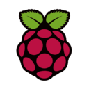
Raspberry Pi
An Introduction

Slide 2
What is Raspberry Pi?
Raspberry Pi is a
low cost, credit-card sized computer
device capable of doing everything a desktop computer can do
device that has the functionality of both a computer and a micro-controller
Raspberry Pi has been used in a wide array of digital maker projects, from music machines and parent detectors to weather stations and tweeting birdhouses with infra-red cameras.
In this course we use Raspberry PI 3 as it comes with built-in WiFi and Bluetooth module.
Notes:
https://www.raspberrypi.org/help/what-is-a-raspberry-pi/

Slide 3
Introduction
Built on the latest Broadcom 2837 ARM System on Chip (SoC), 64-bit processor, the new generation Raspberry Pi 3 Model B is faster and more powerful than its predecessors.
It does not include a built-in hard disk or solid-state drive, but uses an SD card for booting and long-term storage.
The Raspberry Pi is a computer, very like the computers with which you’re already familiar. It uses a different kind of processor, so you can’t install Microsoft Windows on it.
Instead we can install several versions of the Linux operating system that look and feel very much like Windows. If you want to, you can use the Raspberry Pi to surf the internet, send an email or write a letter using a word processor.

Slide 4
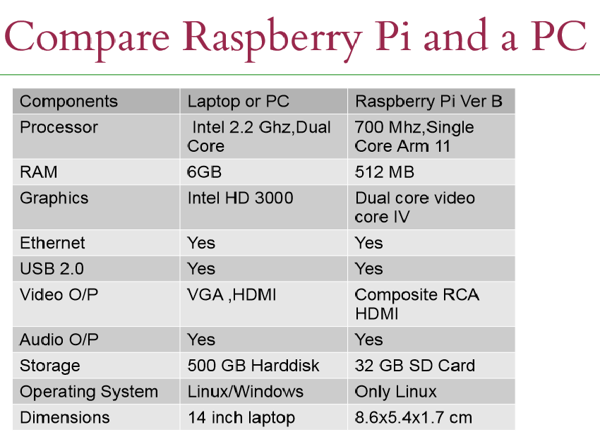
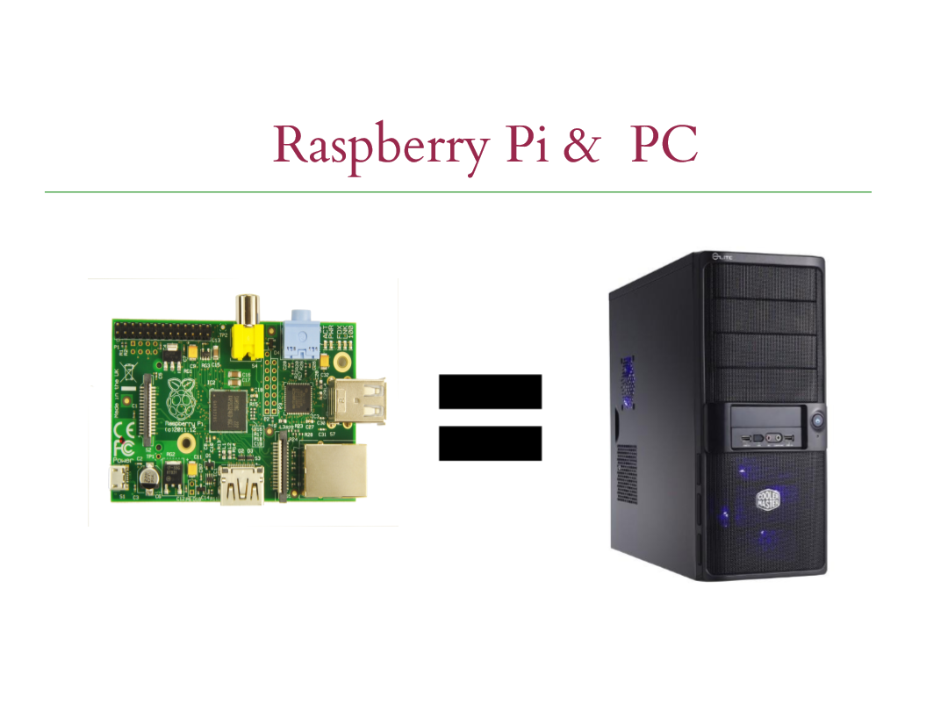
Raspberry Pi : Your own pocket PC

Slide 5
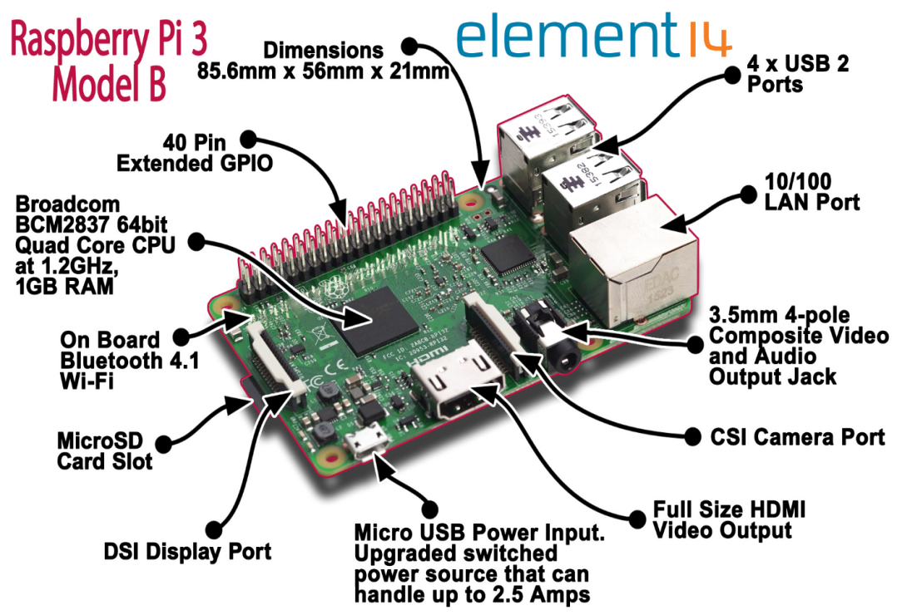
Technical Specifications
System On Chip (SoC) processor
Raspberry Pi 3 [3] Board layout.

Slide 6
Features & Benefits of Raspi 3
Improved Performance
Next generation QUAD Core Broadcom BCM2837 64bit ARMv8 processor
Processor speed has increased from 900MHz on Raspberry Pi 2 to 1.2GHz on Raspberry Pi 3
Improved Connectivity
BCM43143 WiFi on board
Bluetooth Low Energy (BLE) on board
Improved Power Management
Upgraded switched power source up to 2.5 Amps (support even more powerful devices over USB ports)
Bluetooth Low Energy (BLE) on board
Notes:
http://www.microcenter.com/site/content/raspberry-pi3b.aspx

Slide 7
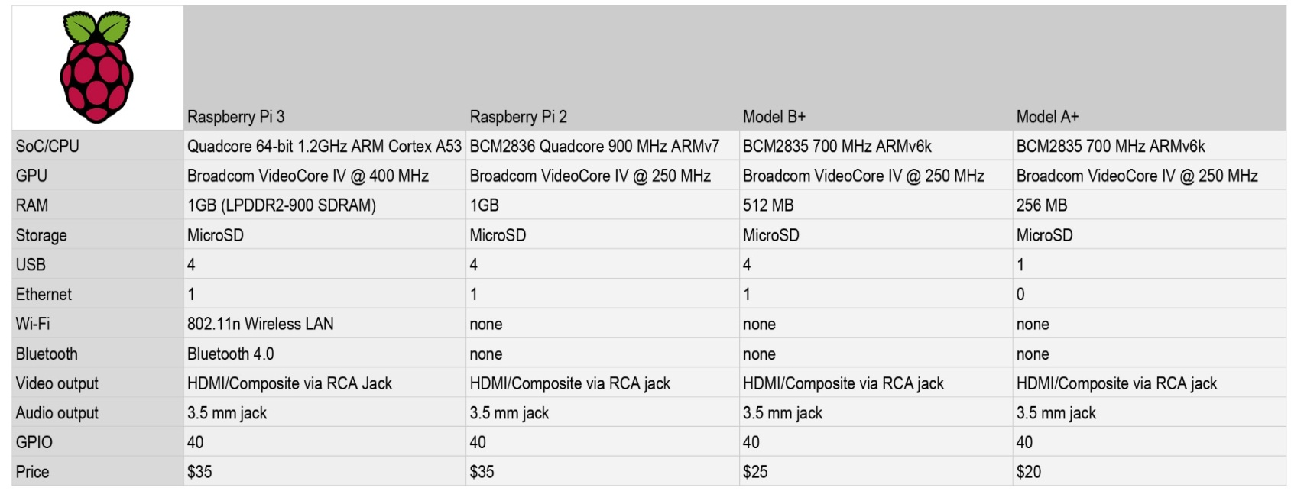
Board Feature Comparison of Raspberry Pi 3 with its predecessors
Notes:
http://lifehacker.com/the-raspberry-pi-3-adds-built-in-wi-fi- and-bluetooth-g-1761317416

Slide 8
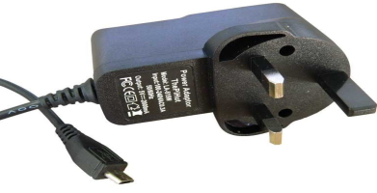
Setting up Raspberry Pi (Hardware setup)
The board needs to be connected to a power equipment which is a mini USB connector and draws current of 700 mA at 5 volts. Can use a micro USB power supply or power it up from the CPU.
The SD card bundled with the Raspbian OS, which is a linux based OS must be inserted into the SD Card slot.
For display, Rpi can be connected to the LCD Tvs or desktop monitor that supports HDMI.
Audio port of 3.5mm must be connected to any amplified speaker set.

Slide 9
Setting up Raspberry Pi (Hardware Setup)
The Ethernet port must be connected to a USB wifi dongle or Ethernet LAN cable (standard RJ45 connector) to support internet connectivity.
There are two USB ports in model B and they can be easily utilized for connecting USB mouse and a USB keyboard.

Slide 10
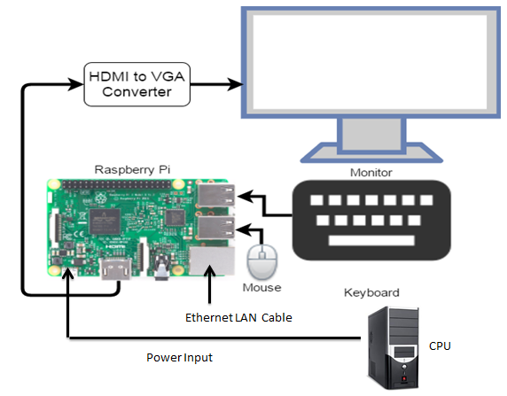
Connection Diagram for Raspberry Pi

Slide 11
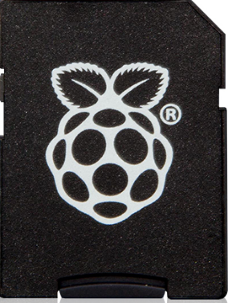
Operating System in Raspberry Pi (OS setup)
The Raspberry Pi uses Linux kernel-based operating systems. Raspbian, a Debian-based free operating system optimized for the Raspberry Pi hardware is the official OS for raspberry pi.
The easiest and quickest way to get started with Raspberry Pi. Recommended for first time Pi users, the Transcend 16GB MicroSD card comes pre-loaded with the official Raspberry Pi New Out of Box Software (NOOBS) package featuring a choice of seven recommended Raspberry Pi Operating Systems including:
Raspbian
Open ELEC
OSMC
Windows 10 IoT Core
Arch Linux
Pidora
RISC OS
16GB NOOBS Micro SD card

Slide 12
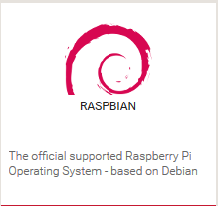
Preparing the SD Card for OS setup in Raspi
If the SD card is already bundled with the NOOBS package, directly insert it into the Raspberry Pi and power it up.
Raspberry Pi will boot, and a window will appear with a list of different operating systems that you can install. We recommend that you use Raspbian – tick the box next to Raspbian and click on Install.
Wait for it to finish. (15 – 20 mins)

Slide 13
Preparing the SD Card for OS setup in Raspi
However, if the SD card is not pre-installed with an Operating Systems or NOOBS, then we have to prepare the SD card and install an Operating system to use Raspberry Pi.
We choose Raspbian OS as it is officially supported and has a big community of users.
Steps to install Raspbian:
Download latest image from
https://www.raspberrypi.org/downloads/raspbian/
Create a bootable SD card from the image
Insert the SD card in Raspberry Pi and power on Raspberry Pi
Go through the installation procedures
Wait for around 10-20 mins to complete the installation
Once installation is completed, you can boot into Raspbian OS
For more information visit:
https://www.raspberrypi.org/documentation/installation/installing-images/

Slide 14
First Boot up of Raspberry Pi
After inserting the SD card in Raspberry Pi once the Raspbian OS is installed, the Raspberry Pi configuration menu (raspi-config) will load.
Here you are able to set the time and date for your region and enable a Raspberry Pi camera board, or even create users.
To enter the Graphical environment enter the Command startx
Default Login ID : pi, Default Password : raspberry

Slide 15
Programming in Raspberry Pi
By default, Raspberry Pi supports UNIX shell scripting, Python or any other language that will compile with ARMv6 can be used with it.
Multiple languages can be used to program in Raspberry Pi. Python, C, C++, Java, Scratch, and Ruby all come installed by default on the Raspberry Pi.
Python is the official programming language of the Raspberry Pi and IDLE 2, a Python Integrated Development Environment (IDE) will be used for writing codes in python.

Slide 16
There are two ways of executing python code in Raspberry Pi:
1) Using the Terminal Window
2) Using Python IDLE 2 , a Python Integrated Development Environment (IDE) that serves as a GUI to write and execute python code
We will be using Python IDLE 2 in lab for a simpler user interactive experience.
For programming using the terminal window , you should be familiar with basic Linux commands.

Slide 17
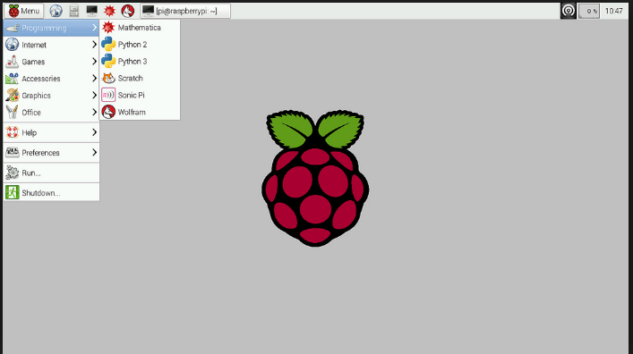
Raspberry Pi Screen after boot up
Terminal Window
Python 2 IDE

Slide 18

Python using IDLE
Python is an interpreted, object-oriented, high-level programming language with dynamic semantics. Python has no compilation step and the edit-test-debug cycle is incredibly fast. Python is used domains ranging from Desktop application development to scientific and numeric computing
We will use Python IDLE 2 to program python applications
Python IDLE 2 and Python IDLE 3 come pre-installed on Raspbian. If needed on any other OS, type the following command in terminal window:
sudo apt-get install python3 or sudo apt-get install python
Notes:
https://www.python.org/doc/essays/blurb/
https://www.python.org/about/apps/

Slide 19
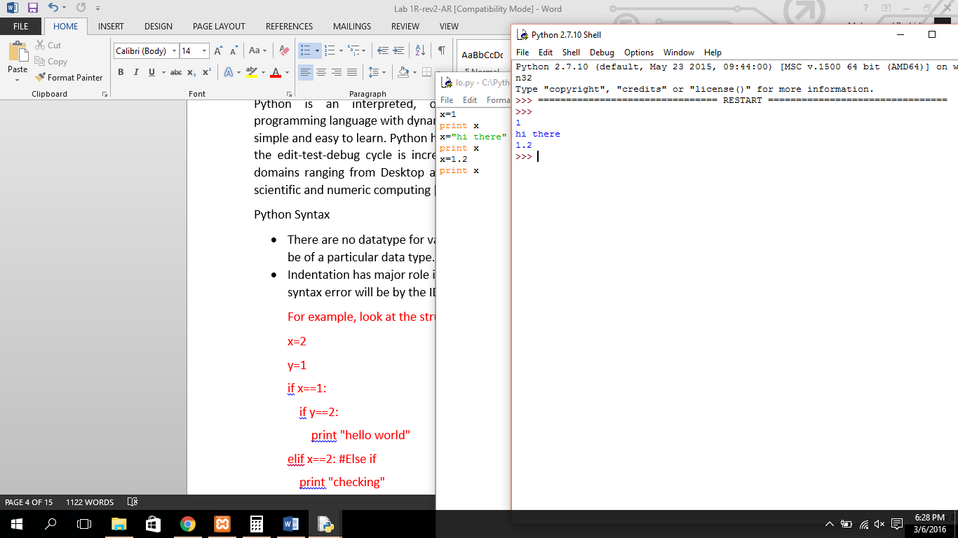
Introduction to Python
There are no datatype for variables, however, one can parse the variable to be of a particular data type.
Example:

Slide 20
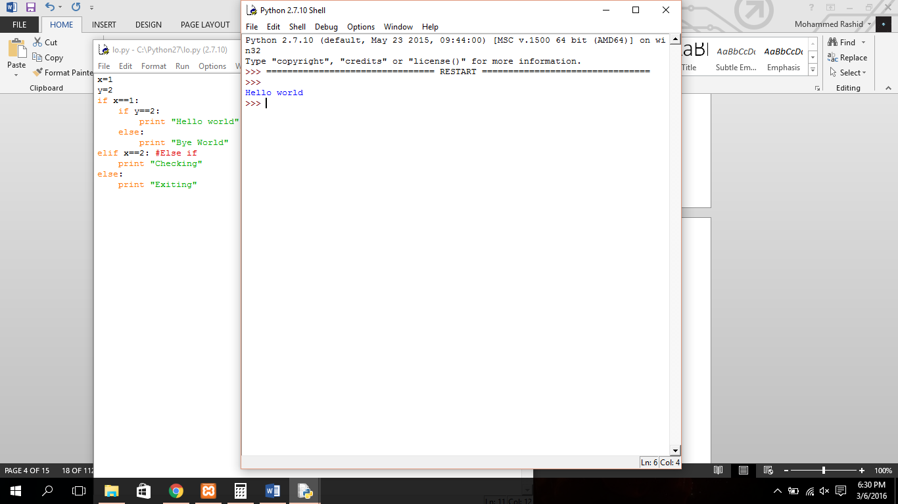
Indentation has major role in python. If code is not properly intended, syntax error will be by the IDE.
There are no semicolons at the end of a statement. Example:

Slide 21
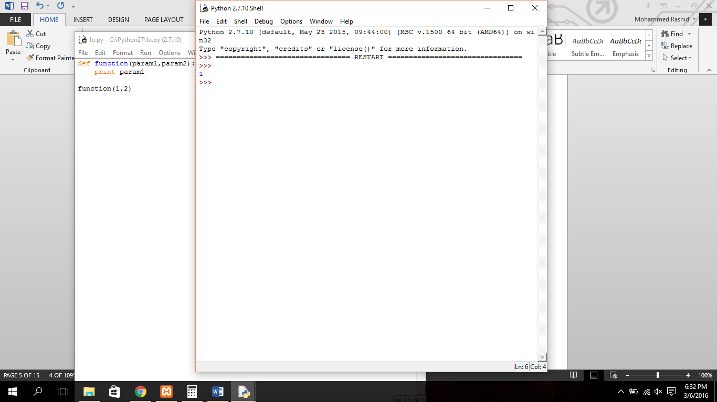
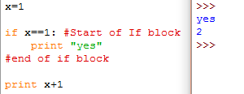
Defining Functions in Python
Functions names have to be preceded with def instead data types. Example:
Code block is starts with :[colon] and everything inside that block has to be intended by a tab space.

Slide 22
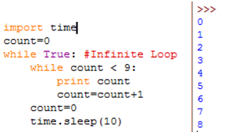
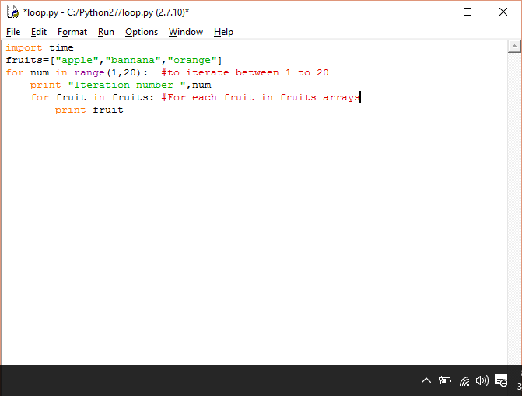
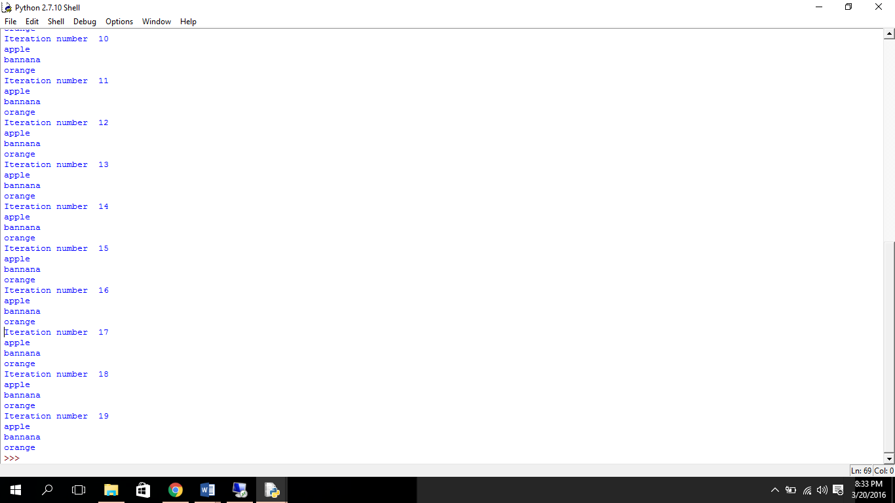
Looping in Python
While Loop:
For Loop:

Slide 23
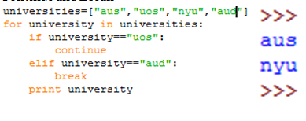
Using the Continue and Break
Using the Continue and Break keyword to function similar to Switch-Case as Switch-Case syntax is supported by Python. Example:

Slide 24
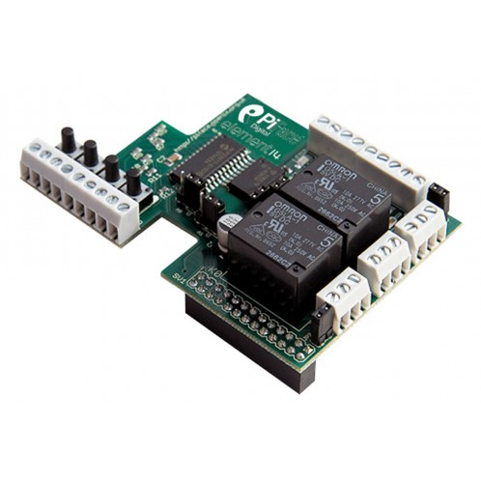
Some useful applications of Raspberry Pi
1) Pi-Face : Hardware + Sensors + Electronics Interfacing.

Slide 25
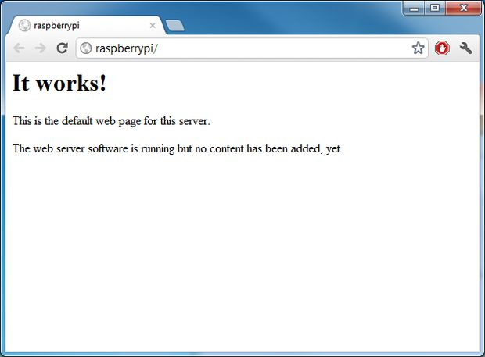
2) Running a Web server on Raspberry
Pi

Slide 26
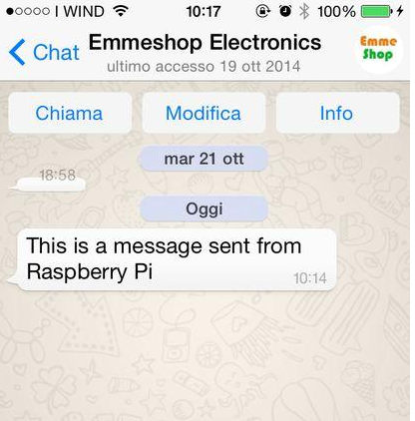
3) Get Whatsapp on your raspberry pi
Now you can send messages directly from the Pi ( follow tutorial from emmeshop. )
All you need to do is to install the latest version of Raspbian, enter a few lines of code and confirm registration using your mobile.
Reference: http://www.instructables.com/id/WhatsApp-on-Raspberry-Pi/

Slide 27
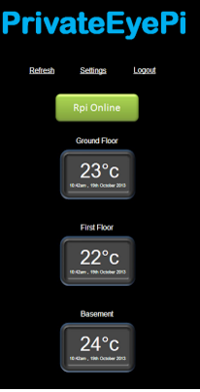
4) Raspberry Pi Temperature Monitor
Reference: http://www.projects.privateeyepi.com/home/temperature-gauge

Slide 28
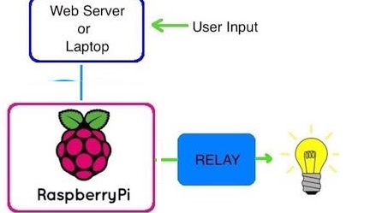
5) Internet Of Things with Raspberry Pi
With Raspi you can now remotely control the ON/OFF of an LED over a Local Area Network (LAN)
Reference: http://www.instructables.com/id/Simple-IOT-project-for-Beginners/

Slide 29
Disadvantages of Raspberry PI:
It does not have a Hard disk associated with it for permanent storage of pi files, need to connect one external SD card for that purpose.
There is no real time clock associated with Raspberry Pi. Adding an RTC is expensive, and you can add one yourself using the GPIOs externally.

